Slide 1
SYNTHETIC RUBBER
SYNTHETIC RUBBER:
It is obtained naturally as latex from the rubber tree.
It is cheaper than natural rubber.

Slide 3
SYNTHETIC ADHESIVES:
Materials such as glue and gum that are used to stick things are called adhesives.
It is stronger than natural adhesives.

Slide 4
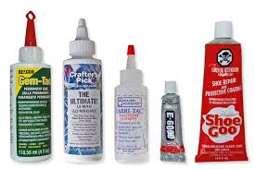
USES

